Slide 1
Midterm Proposal
Atharv Gopaluni

Slide 2
Concept
I want to make a website to showcase my media “company.” I have both current projects and upcoming projects that I want to showcase and explain, alongside explaining my goals and messages. I also want an about me, linking to my own personal website.

Slide 3
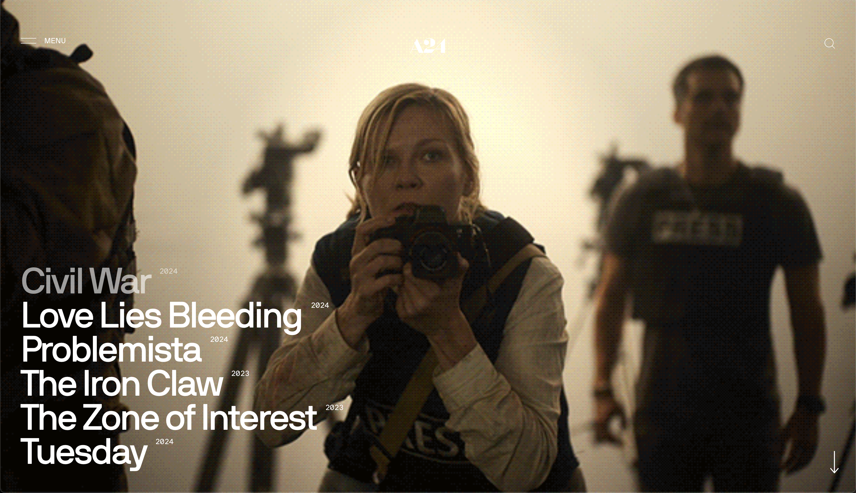

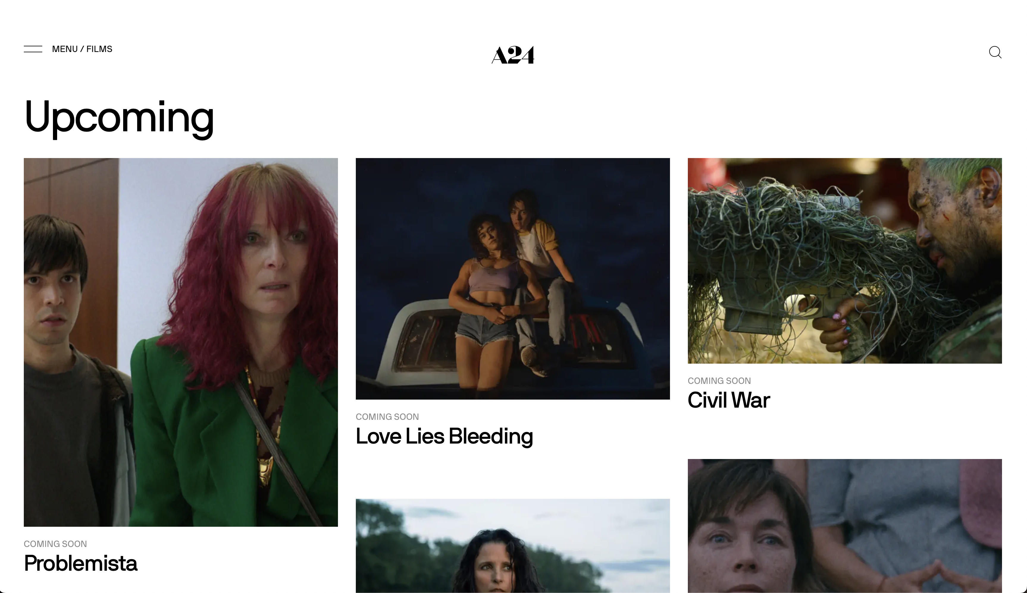
Inspiration
https://a24films.com
https://www.warnerbros.com/collections
My goal is to create a website that invokes this idea of media, immediately portraying that.
A24 home page
A24 films page
A24 menu nav bar

Slide 4
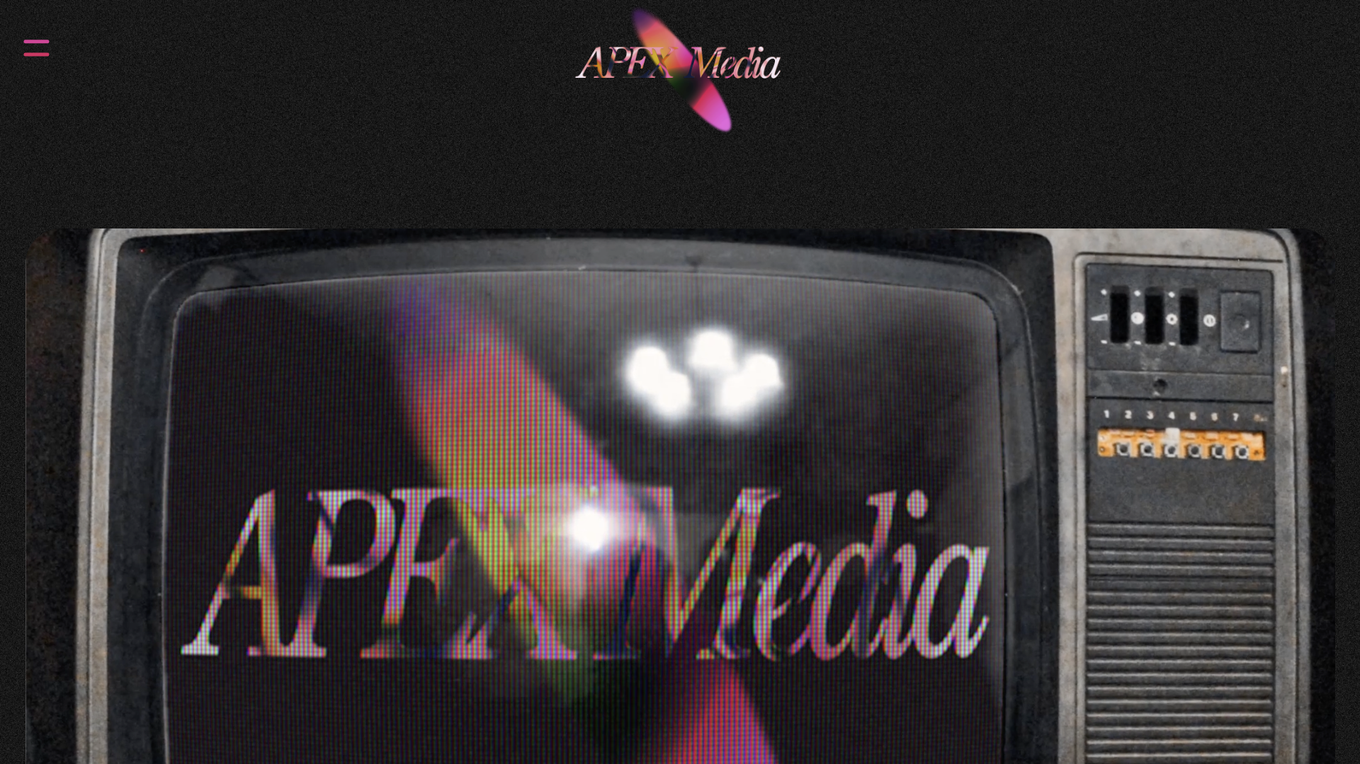
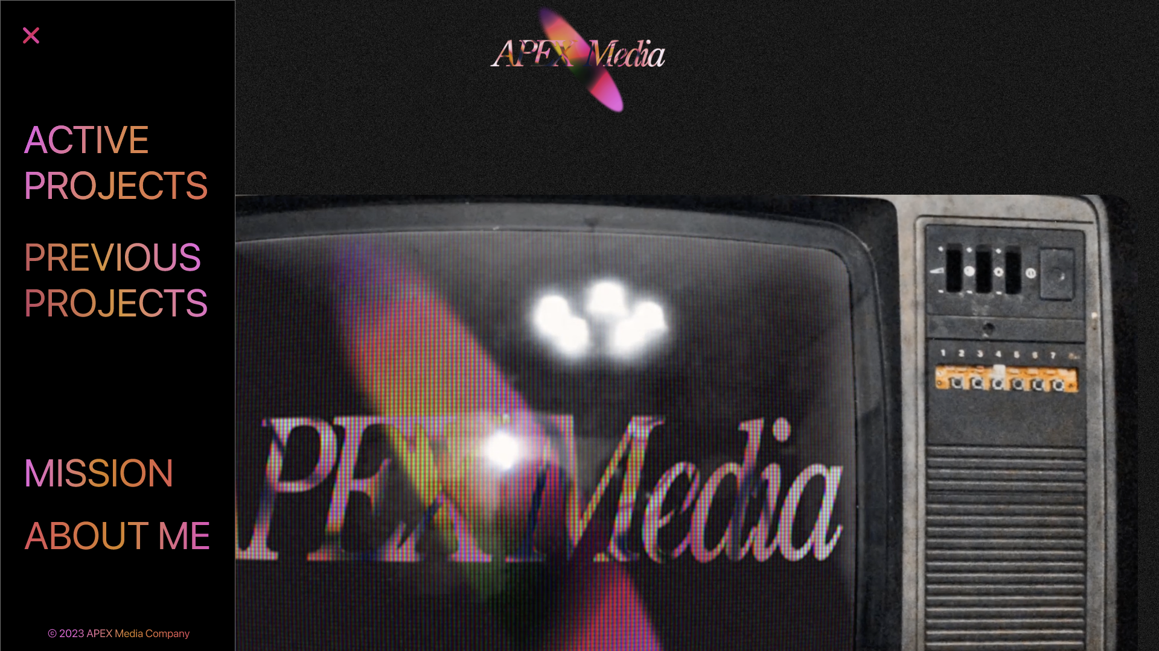
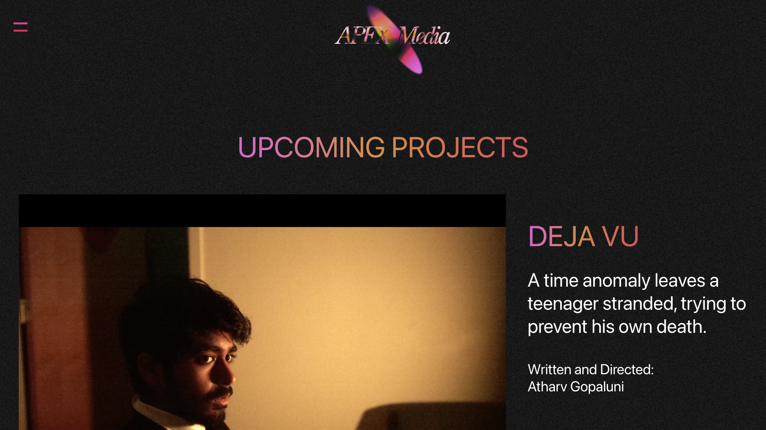
Schematics/Wireframing

Slide 5
CSS/HTML that I will utilize
Text styles
Page navigation
Link navigation
Flex box
Image editing/scaling
Headings
Page breakdowns
Navbar creation
Dropdowns
Text input (for possible search feature, if needed)
Video scaling (extension of media like images)
Responsiveness for website
Background styling

Slide 6
Future/Required skills
Further skills in animation for scrolling
Working with gradients
Further exploration of advanced navbars

